Slide 1
Digital Image Processing
Lecture 6:
Ch3:Image Enhancement in the Spatial Domain:
3:7 Sharpening Spatial Filters
Dr. Hossam Mahmoud Moftah
Assistant professor – Faculty of computers and information –
Beni Suef University

Slide 2
Sharpening Spatial Filters
Foundation
Laplacian Operator (Lab Assignment using Matlab)
Unsharp Masking and Highboost Filtering
Using First-Order Derivatives for Nonlinear Image Sharpening
  Robert Cross Gradient Operator
  Sobel Operator (Lab Assignment using Matlab)
  Prewitt operator (Lab Assignment using Matlab)

Slide 3
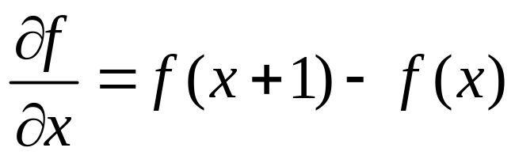
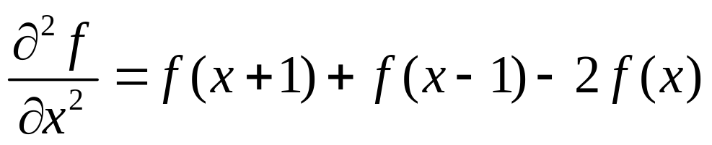
Sharpening Spatial Filters: Foundation
The first-order derivative of a one-dimensional function f(x) is the difference
The second-order derivative of f(x) as the difference

Slide 4
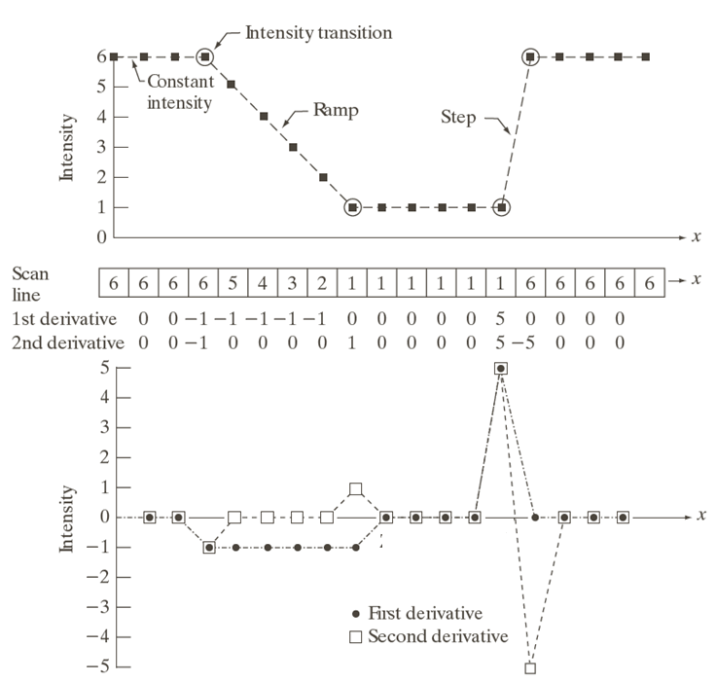
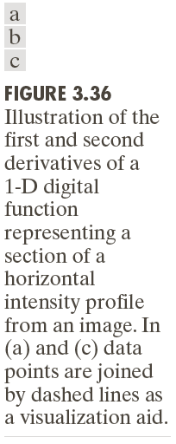

Slide 5
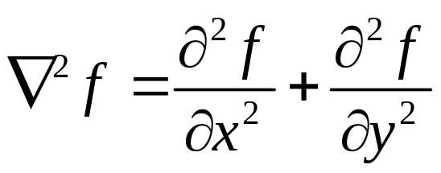
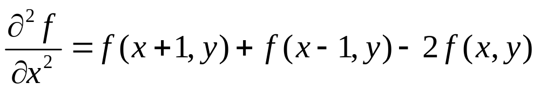
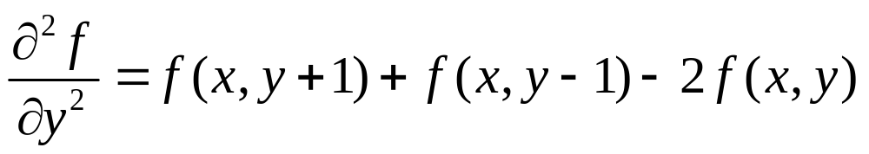
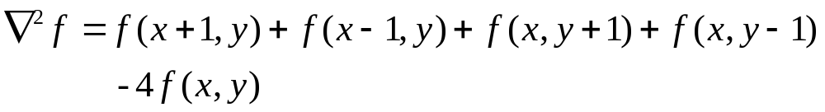
Sharpening Spatial Filters: Laplace Operator
The second-order isotropic derivative operator is the Laplacian for a function (image) f(x,y)

Slide 6
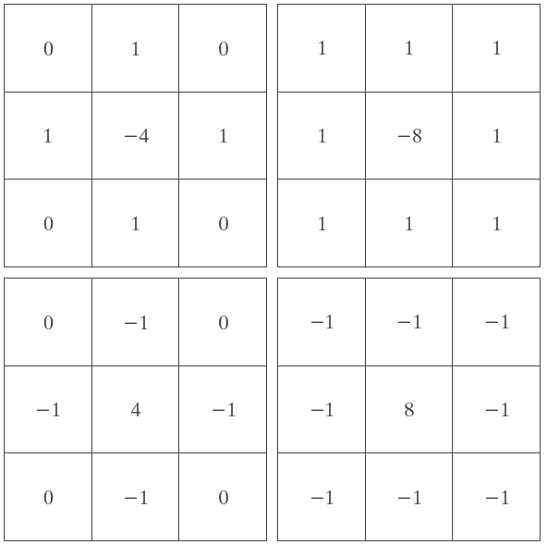
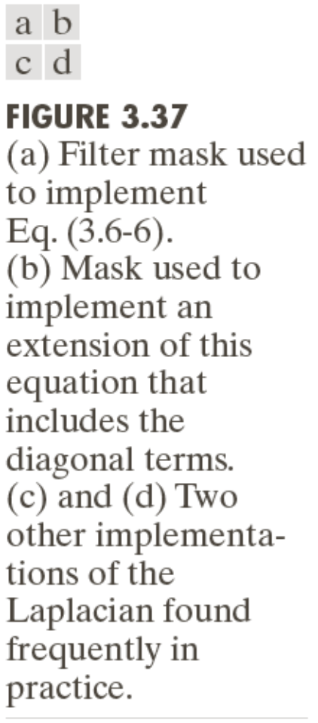
Sharpening Spatial Filters: Laplace Operator

Slide 7
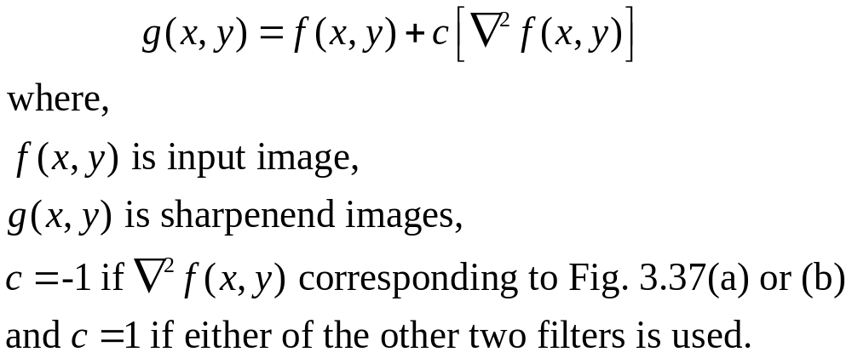
Sharpening Spatial Filters: Laplace Operator
Image sharpening in the way of using the Laplacian:

Slide 8
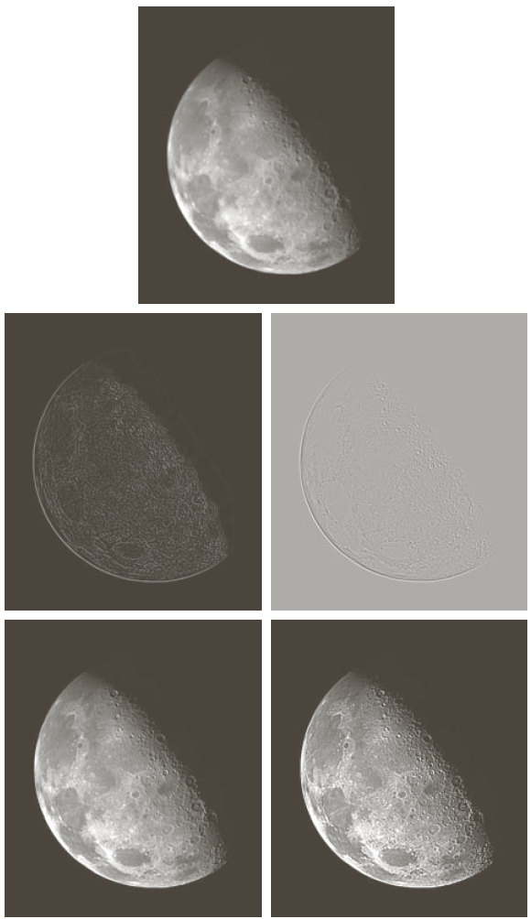
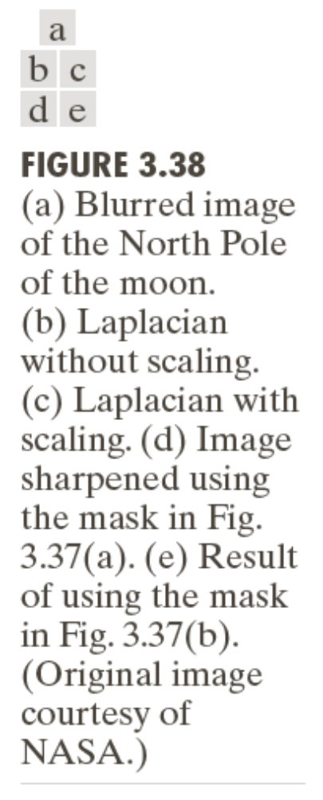

Slide 9
Unsharp Masking and Highboost Filtering
Unsharp masking
Sharpen images consists of subtracting an unsharp (smoothed) version of an image from the original image
e.g., printing and publishing industry
Steps
1. Blur the original image
2. Subtract the blurred image from the original
3. Add the mask to the original

Slide 10
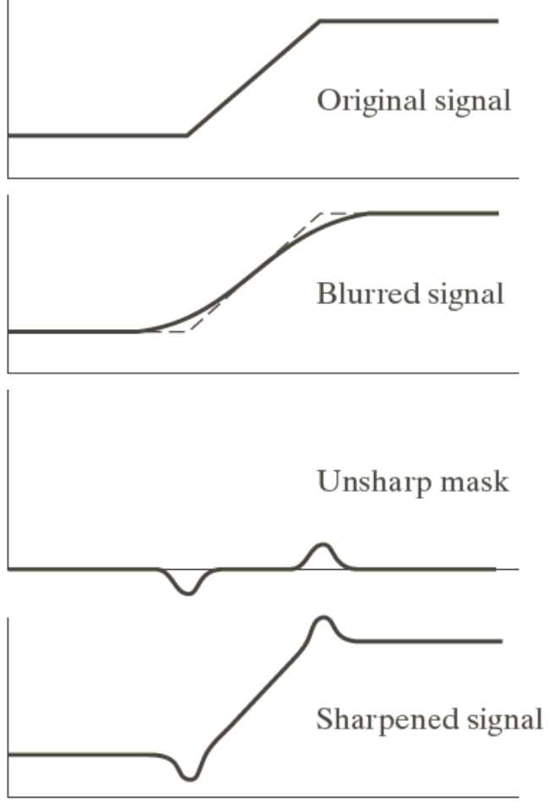
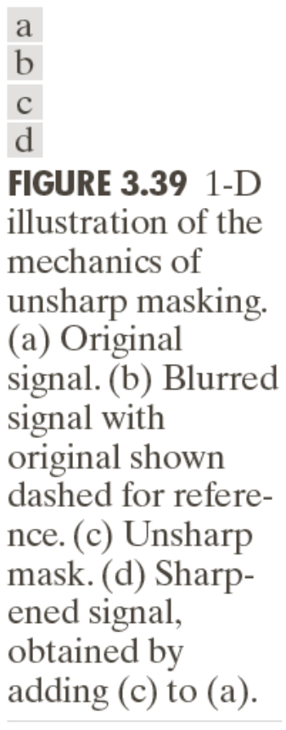
Unsharp Masking:

Slide 11
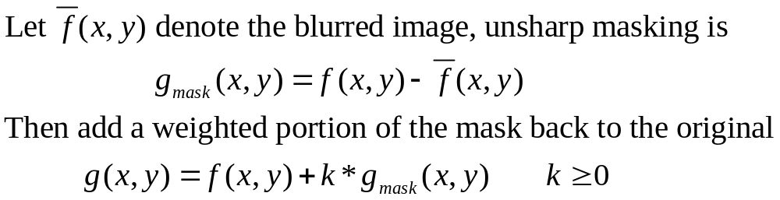
Unsharp Masking and Highboost Filtering

Slide 12
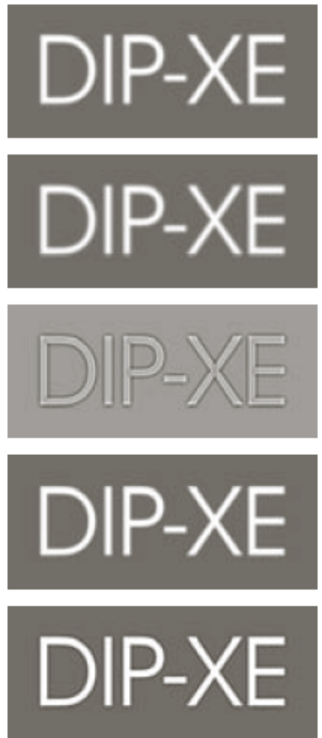
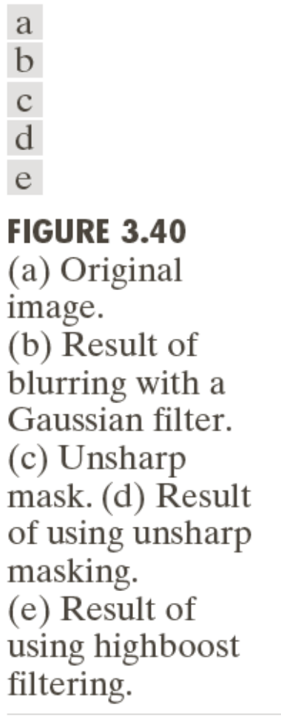
Unsharp Masking and Highboost Filtering: Example

Slide 13
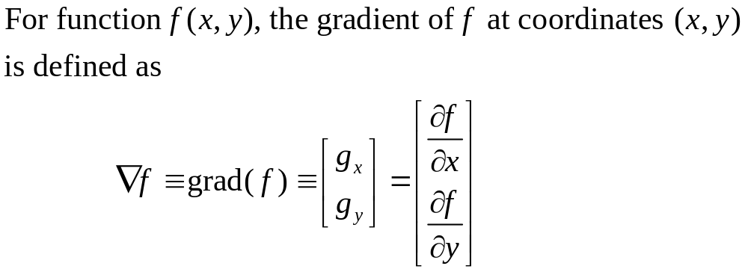
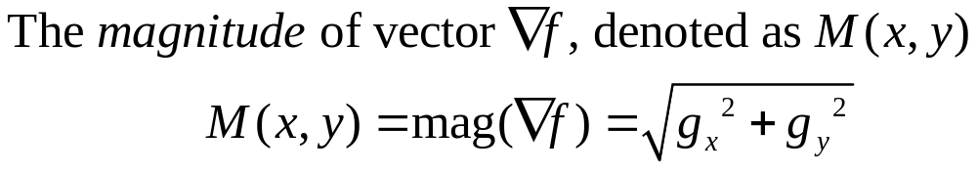

Edge Detection using Gradient
Gradient Image
Using this information, we can also calculate the gradient's direction:

Slide 14
Edge Detection using Gradient
Using this information, we can also calculate the gradient's direction:

Slide 15
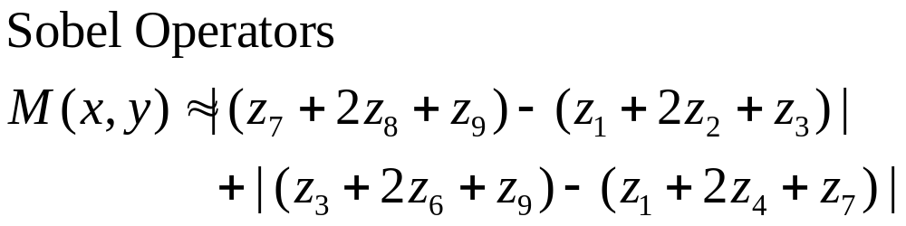
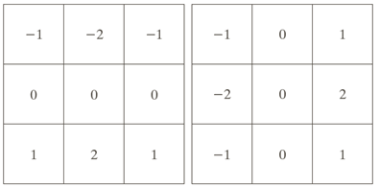
How to Compute Gradient?
1- Sobel Operator
z₁ | z₂ | z₃
z₄ | z₅ | z₆
z₇ | z₈ | z₉

Slide 16


How to Compute Gradient?
2- Prewitt operator
Gx=
Gy=

Slide 17
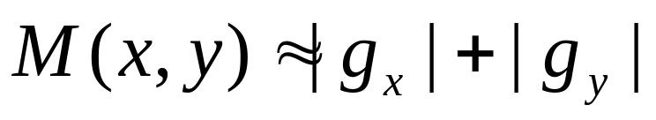
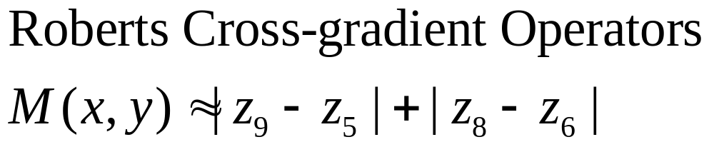
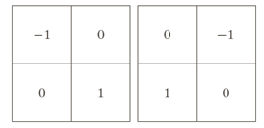
How to Compute Gradient?
3- Robert Cross Gradient Operator
z₁ | z₂ | z₃
z₄ | z₅ | z₆
z₇ | z₈ | z₉

Slide 18
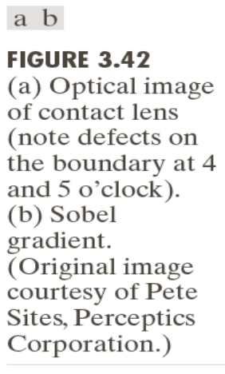
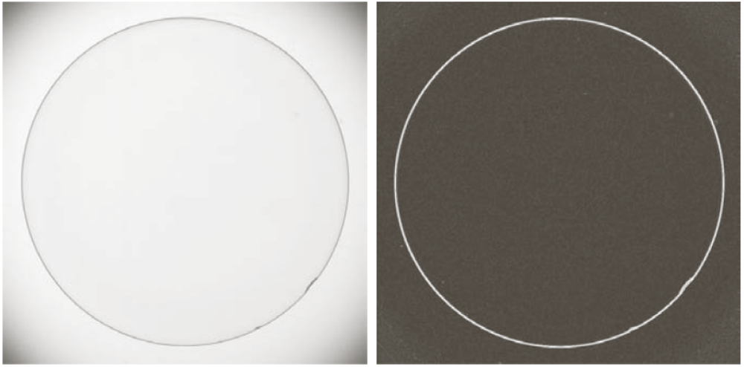
Example

Slide 19

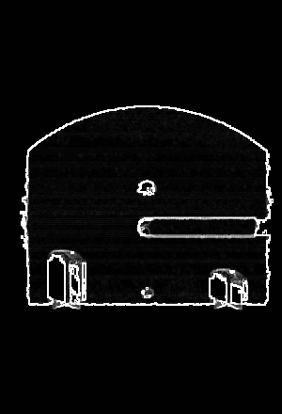
Applying the Sobel operator- Example

Slide 20
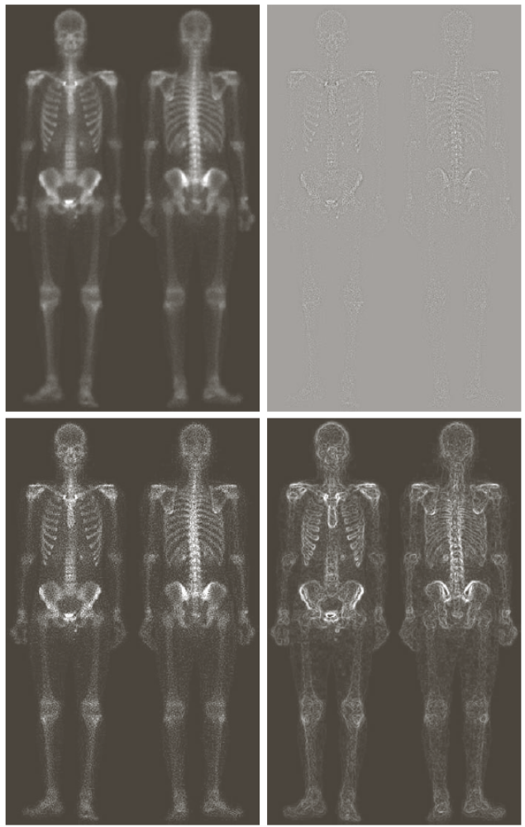
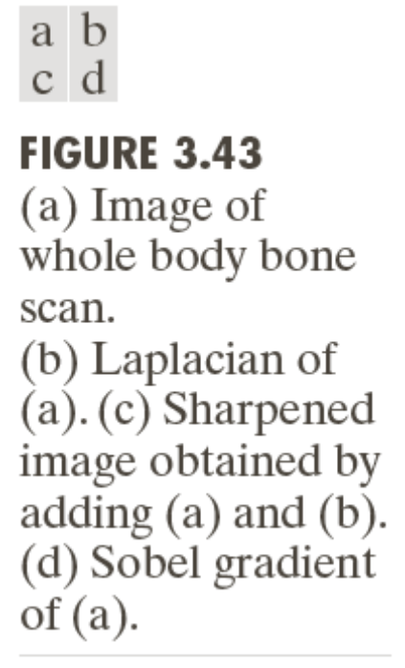


Slide 21
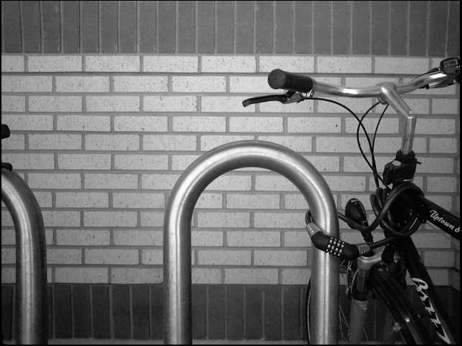
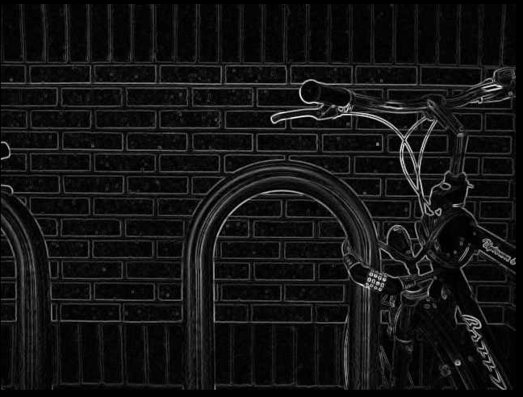
Applying the Prewitt operator- Example

Slide 22
The end

